Slide 1
Sentiment Analysis on Songs Based on Song Lyrics using Naïve Bayes Algorithm
Ayessa Amor N. Hernandez

Slide 2
Background of the Study
Music induces basic to complex emotions such as happiness, sadness, and nostalgia (Juslin et al., 2014)
“Lyrics appear to have greater power to direct mood change than music alone and can imbue a particular melody with affective qualities”. (Stratton and Zalanowski, 1994)
Sentiment analysis: a Natural Language Processing technique to extract sentiments from texts like lyrics.

Slide 3
Background of the Study
Previous studies mostly focus on the audio feature of music but lyric features have proved its usefulness in mood classification.
Need to explore other classifiers such as Naïve Bayes
Need to use a larger dataset when training and testing while producing higher accuracy scores
No existing open-source sentiment-classified datasets with readily available lyrics

Slide 4
Review of Literatures
In a study by Raschka (2016), they manually labeled their 1200 dataset (1000 for training and 200 for testing) into happy and sad categories.
Used NB and got 80% accuracy in training and 54.5% in testing
In another study by Tan et al. (2019) on music mood recognition using lyrics, they used the Naïve Bayes algorithm to train 120 songs and test 60 songs and their model got an 85% accuracy score

Slide 5
Objectives
The main objective of this study is to evaluate the performance of the Naive Bayes classifier algorithm on sentiment analysis based on song lyrics, thus the specific objectives are as follows:
Collect song lyrics from the internet
Apply data cleaning and data preprocessing (tokenization, feature extraction techniques, etc.) to the dataset
Train and test the dataset
Evaluate the performance of the classifier

Slide 6
Significance of the Study
Music Information Retrieval (MIR)
music recommendation systems and music search engines
Music Emotion Recognition (MER)
recommendation systems, automatic music composition, psychotherapy, and music visualization
Music Psychology
music composition, performance, education, criticism, therapy, and studies of human attitude, performance, intelligence, creativity, and social behavior

Slide 7
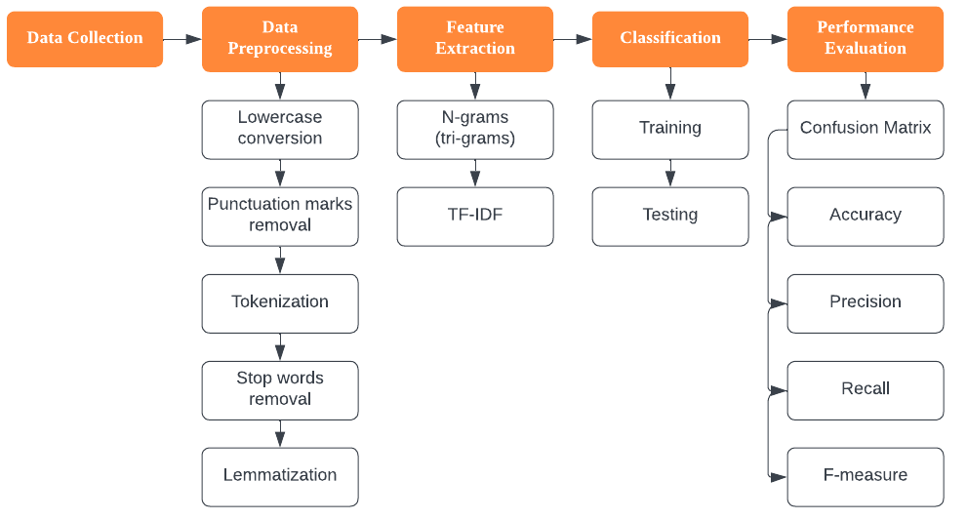
Methodology

Slide 8
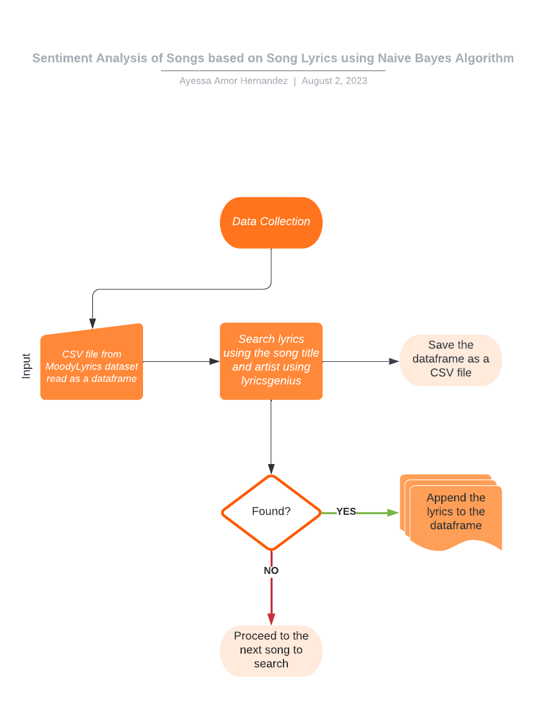
Methodology
Notes:
Data Collection
lyricsgenius python library
Dataset: MoodyLyrics (sentiment-labeled dataset)
From 2,000 songs to 1,970 songs
985 songs for each mood ⎯ positive and negative

Slide 9
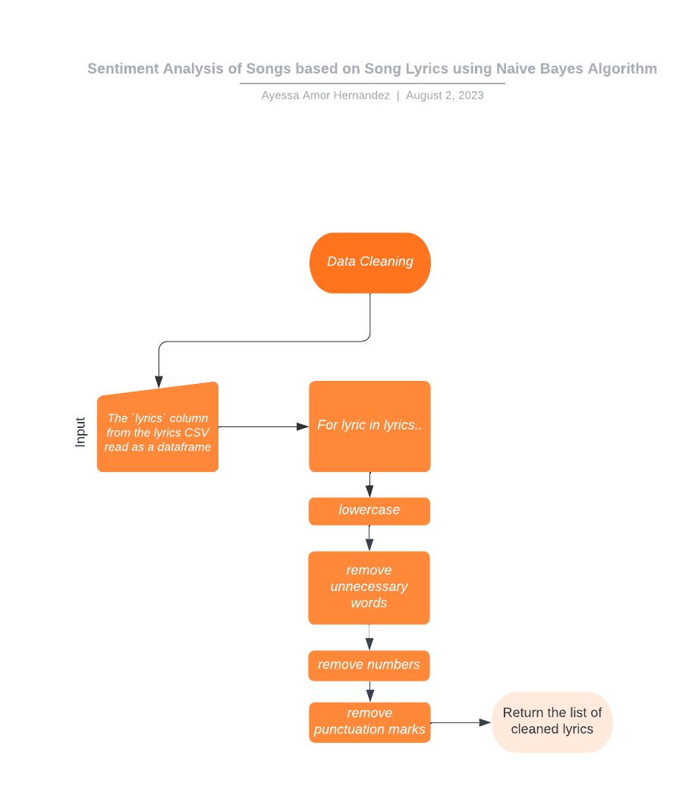
Methodology

Slide 10
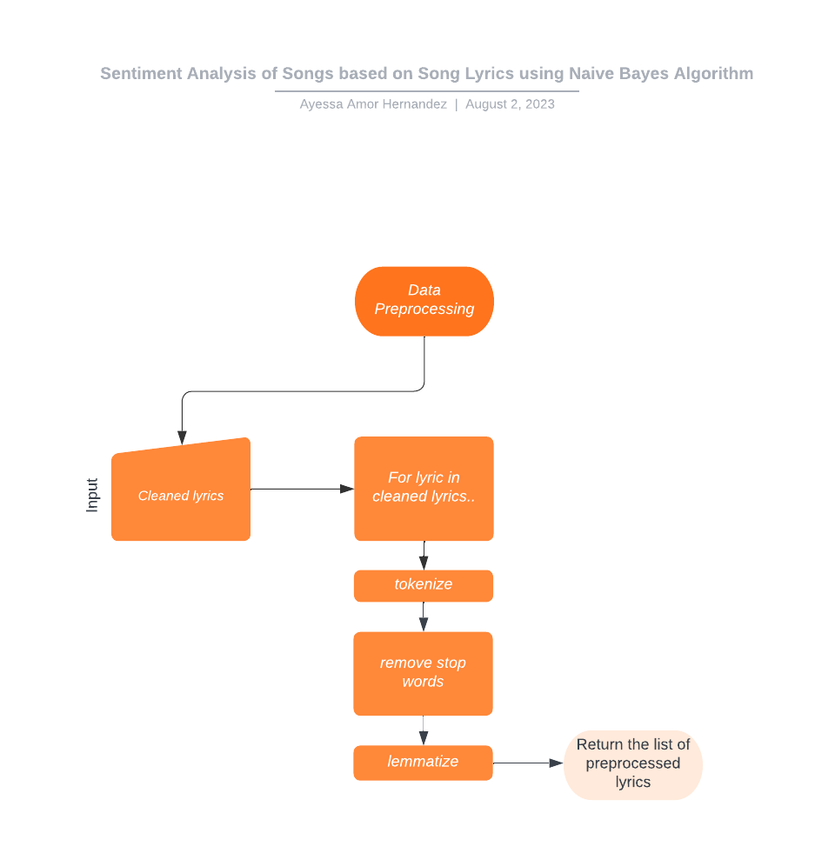
Methodology
Notes:
Data Preprocessing
Used Natural Language Toolkit (NLTK)
Tokenization: word_tokenize()
Stop words removal: NLTK corpus for stop words + “yeah”, “ohh”, “ahh”, and “oooh”
Lemmatization: WordNet Lemmatizer

Slide 11
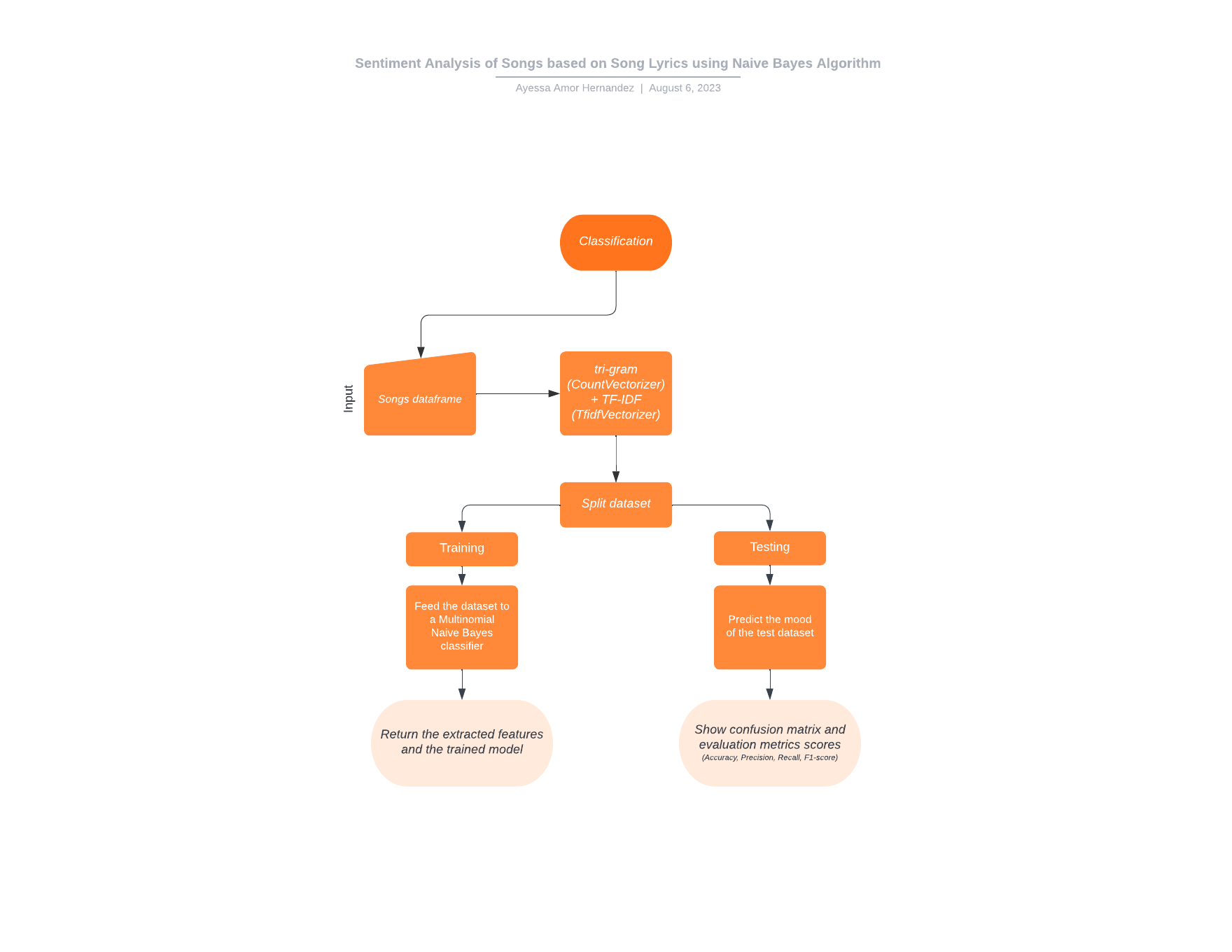
Methodology
Notes:
Feature Extraction
Used CountVectorizer and TfidfVectorizer of sklearn
TF-IDF
a word that frequently occurs in a document but rarely in the entire corpus is more informative than a word that frequently occurs in both the document and the corpus
Classification
Used sklearn
Naïve Bayes classifier
The 1,970 song lyrics dataset
2/3 for training = 1,313 song lyrics
1/3 for testing = 657 song lyrics

Slide 12
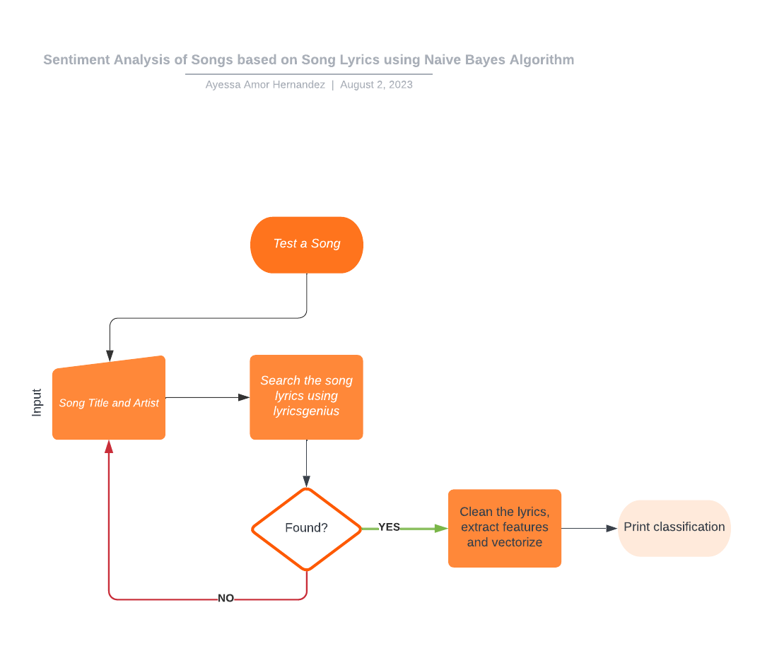
Methodology

Slide 13
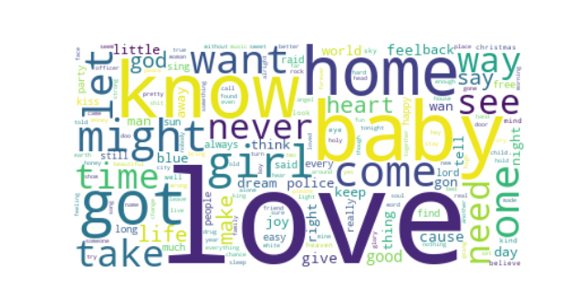
Results
Word clouds
Positive mood word cloud

Slide 14
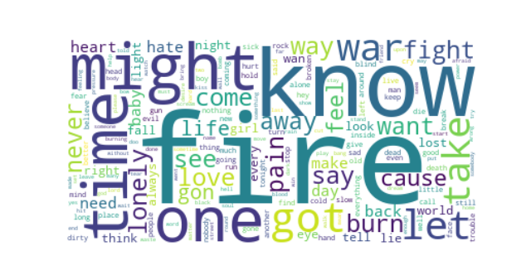
Results
Word clouds
Negative mood word cloud

Slide 15
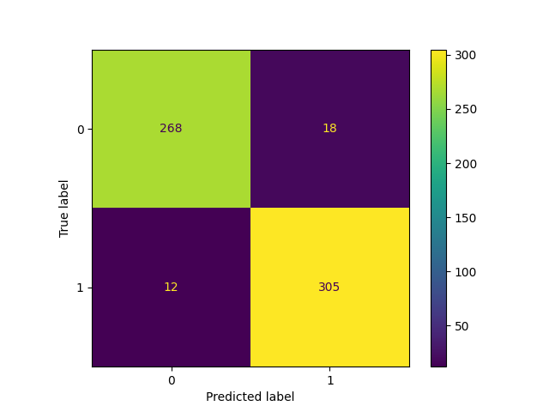
Results
Confusion Matrix
Notes:
Total testing data = 603
Pos class = 323
Neg class = 280
Pos Precision = 305/323 = 94.42%
Neg Precision = 268/280 = 95.71%

Slide 16
Results
Accuracy | 95.02%
Precision | 94.42%
Recall | 96.21%
F1-score | 95.31%

Slide 17
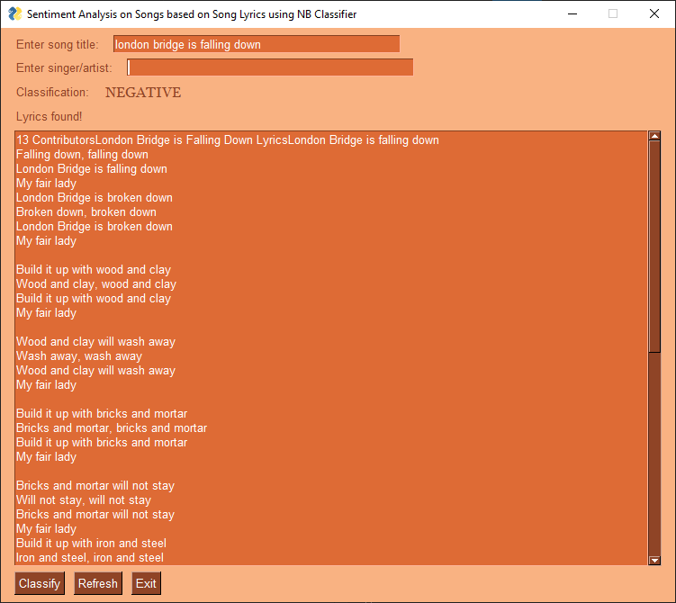
Results

Slide 18
Conclusion and Recommendations
LyricsGenius is not recommended for larger datasets
With proper data pre-processing and feature extraction techniques, the Naive Bayes algorithm serves as a powerful tool in song lyrics mood classification.
Despite observing exceptional results in this study, this work can be improved by using a much larger dataset to see the stability of the effectiveness of the classifier.

Slide 19
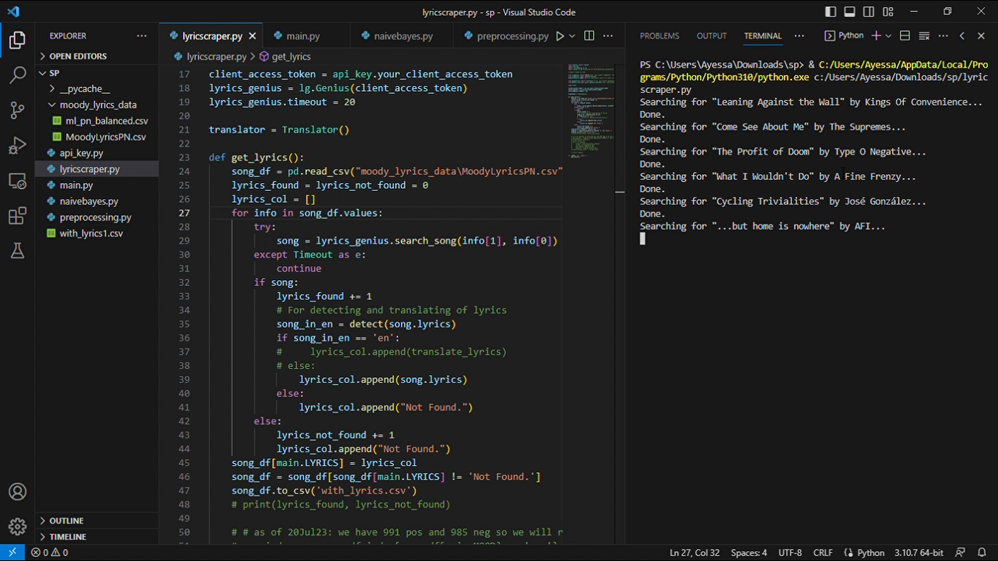
Data collection

Slide 20
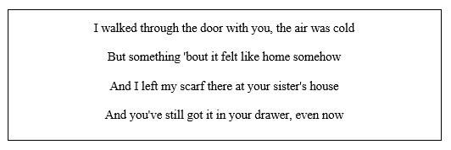
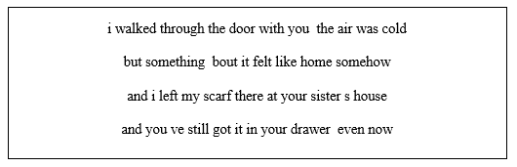
Sample data preprocessing
Sample lyrics found
After cleaning

Slide 21

Sample data preprocessing
After cleaning
After preprocessing

Slide 22
For Testing
Songs to test:
Can’t Help Falling in Love – Elvis Presley
Revolution – The Beatles
Flowers – Miley Cyrus
When I Was Your Man – Bruno Mars
Sad Song – We the Kings
War – Edwin Starr
Angry Again – Megadeth
Twinkle, Twinkle Little Star
If You’re Happy and You Know It
London Bridge is Falling Down

Slide 23
Timetable
Date | Task(s) Done
10-17 July 2023 | Code writing
18-19 July 2023 | Data collection
20 July 2023 | Data cleaning and data preprocessing
21 July 2023 | Classifier training and testing
22 July 2023 | Bugs detected
22-27 July 2023 | Bugs fixing
24-30 July 2023 | Writing of paper
31 July 2023 | Consultation
1-8 August 2023 | Code and paper revisions

Slide 24
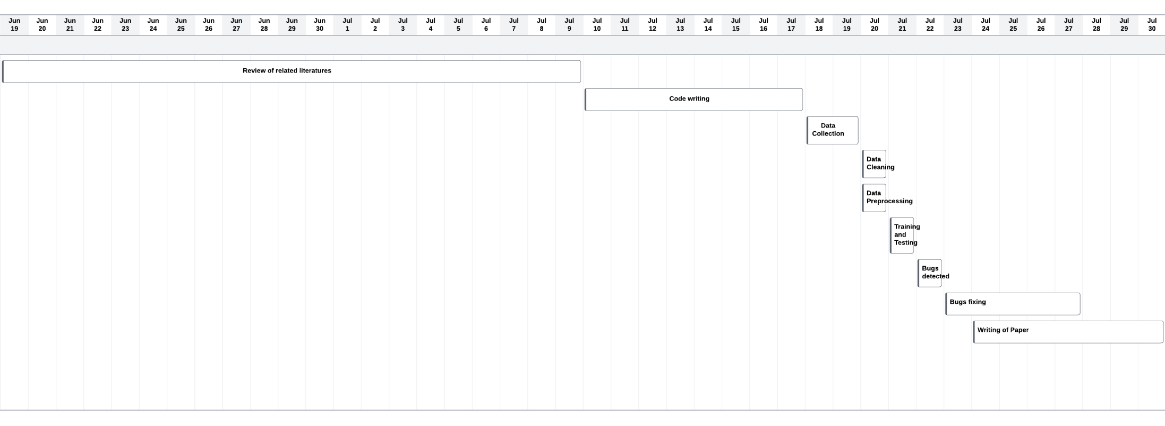
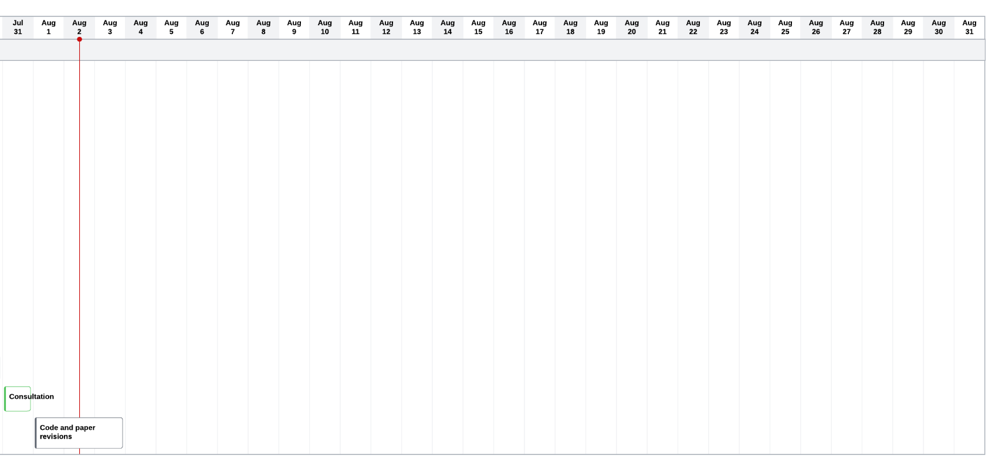
Gantt Chart

